Slide 1
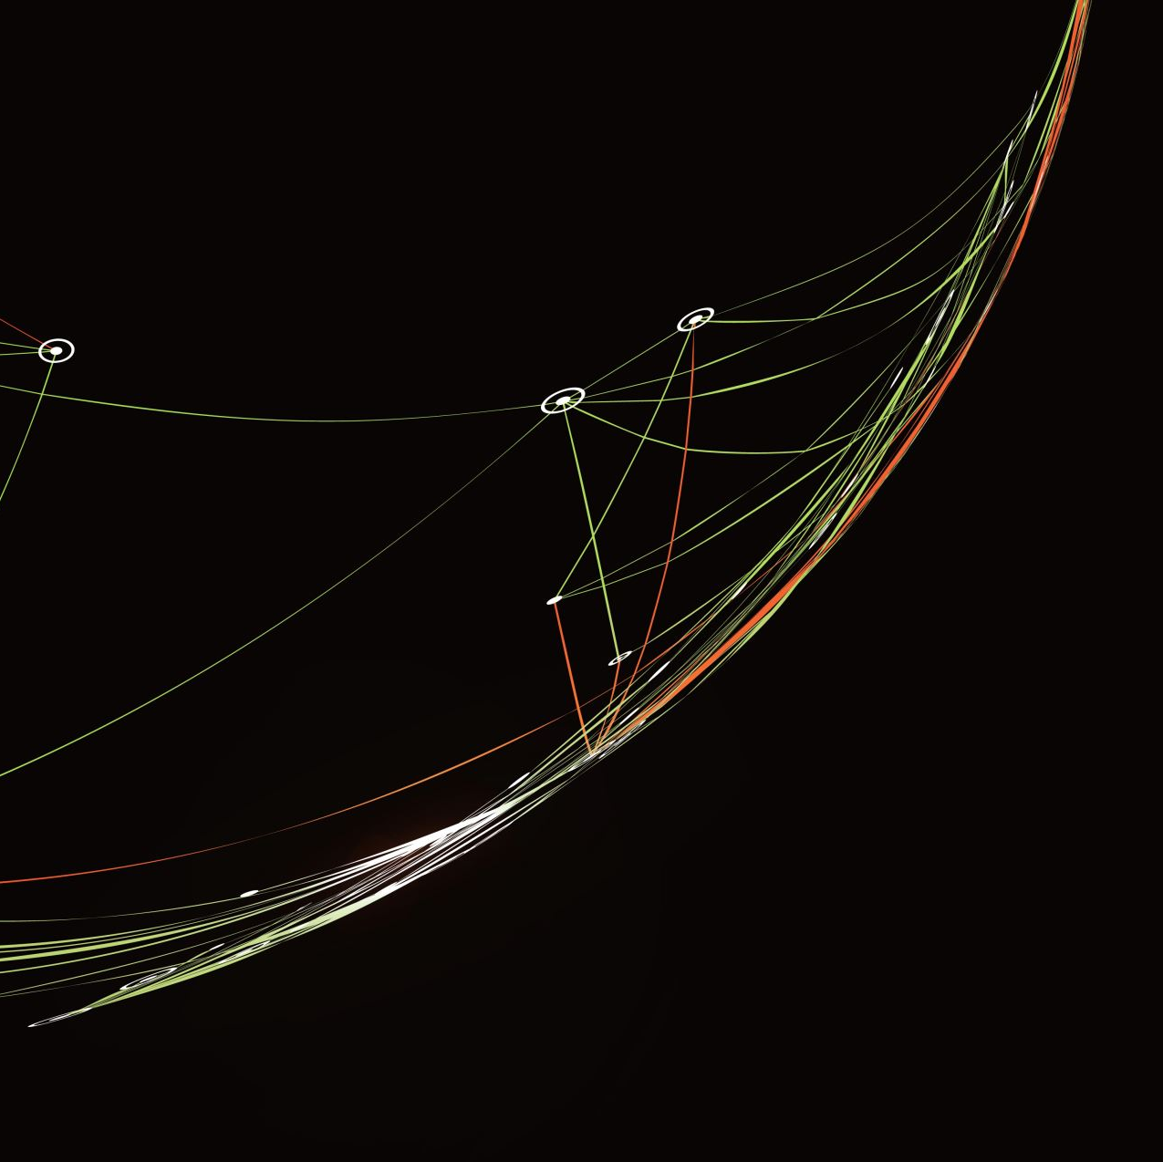
net.art Process Book
Liv West~ Art 2602~ Spring 2022

Slide 2

Synopsis
The following entails my process in developing my very own set of web pages using net.art. I will utilize photo editing software (photoshop), as well as web building tools like HTML and CSS. This project can be accessed on my personal website.

Slide 3
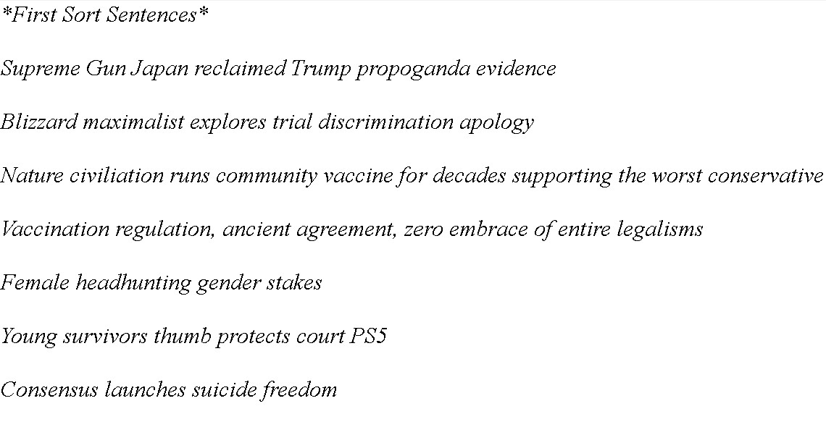
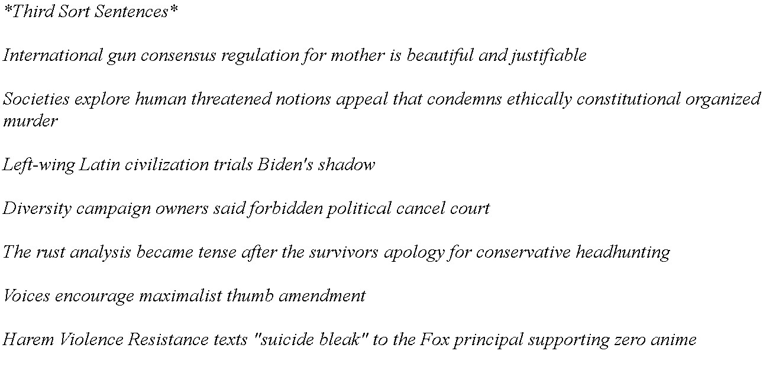
Sentence Forming
First sorting sentences
Third sorting sentences

Slide 4
“Vaccination regulation, ancient agreement, zero embrace of entire legalisms.”
Vaccination: is a biological preparation that provides active acquired immunity to a particular infectious disease.
Regulation: is broadly defined as imposition of rules by government, backed by the use of penalties that are intended specifically to modify the behavior of individuals as well as firms in the private sector.
Ancient: belonging to the very distant past and/or no longer in existence.
Agreement: a negotiated and typically legally binding arrangement between parties as to a course of action.
Embrace: accept or support (a belief, theory, or change) willingly and enthusiastically.
Legalism: in ancient China was a philosophical belief that human beings are more inclined to do wrong than right because they are motivated entirely by self-interest and require strict laws to control their impulses.

Slide 5

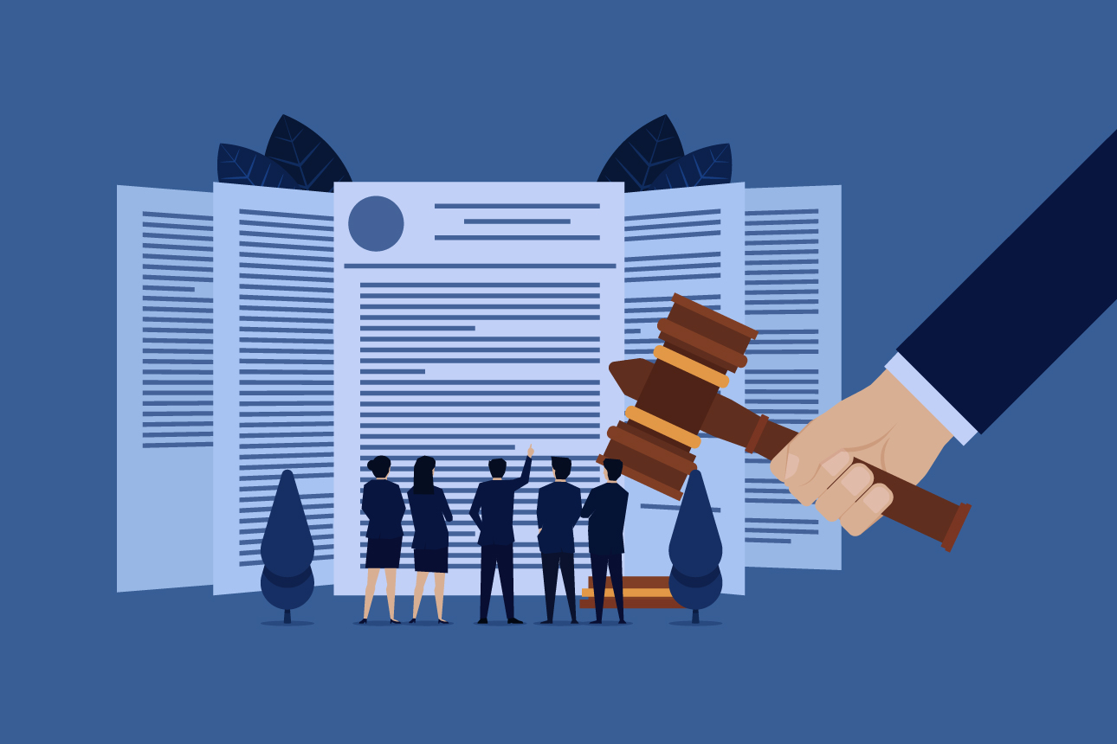


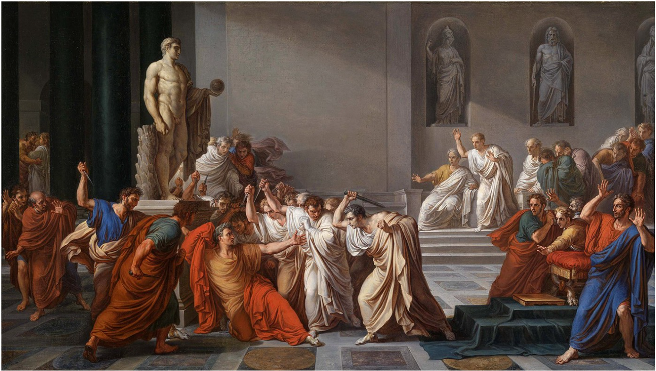
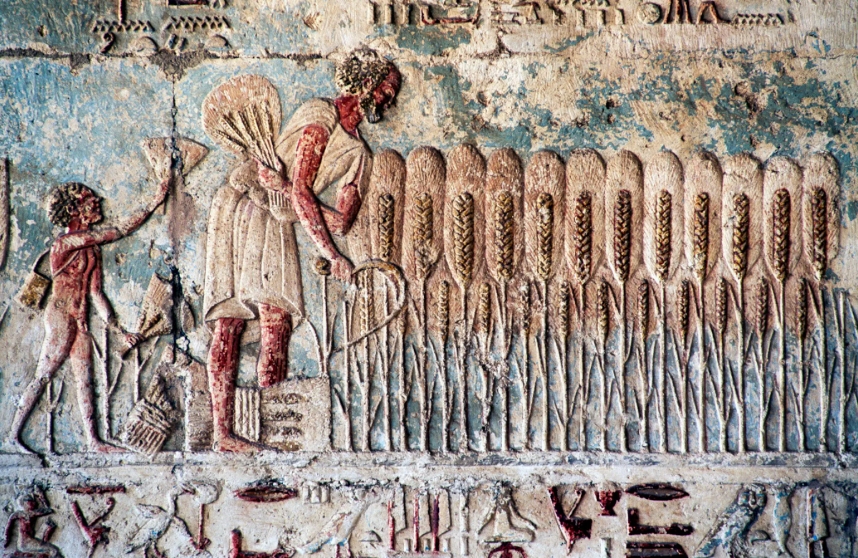
Images

Slide 6



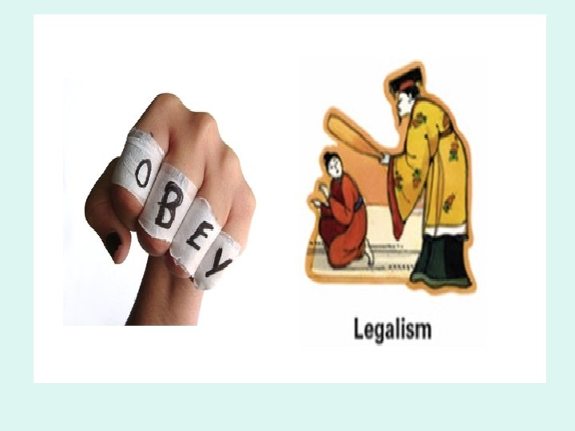


Images

Slide 7

Works Cited:
Feinzig, Joshua, and Joshua Zoffer. “A Constitutional Case for Gun Control.” The Atlantic, Atlantic Media Company, 28 Oct. 2019, www.theatlantic.com/ideas/archive/2019/10/constitutional-case-gun- control/600694/.
Fillari, Alessandro. “How Horizon Forbidden West Became a Showcase for the PS5.” CNET, CNET, 4 Mar. 2022, www.cnet.com/tech/gaming/how-horizon-forbidden-west-became-a-showcase-for-the-ps5/.
Flood, Brian. “CNN's Jim Acosta Agrees with Guest Comparing GOP Not Supporting Gun Control to 'Human Sacrifice'.” Fox News, FOX News Network, 31 Jan. 2022, www.foxnews.com/media/cnn-jim-acosta- mass-human-sacrifice.
Mark, Emily. “Legalism.” World History Encyclopedia, World History Encyclopedia, 2 Apr. 2022, https://www.worldhistory.org/Legalism/.
Morrissy, Kim. “Anime Studio White Fox Apologizes for Alleged Gender Discriminatory Hiring Practices.” Anime News Network, 1 Mar. 2022, www.animenewsnetwork.com/news/2022-03-01/anime-studio-
white-fox-apologizes-for-alleged-gender-discriminatory-hiring-practices/.183123.
Weeks, Paige, and Lauren Scharf. “Domestic Violence Group Condemns Judge in Morphew Trial, Calls Recent Decision 'Pretty Disappointing'.” FOX21 News Colorado, FOX21 News Colorado, 5 Mar. 2022, www.fox21news.com/barrymorphewfox21/domestic-violence-group-condemns-judge-in-morphew- trial-calls-recent-decision-pretty-disappointing/.

